Slide 1
Classical Genetics
Fundamental Genetics and Inheritance Patterns

Slide 2

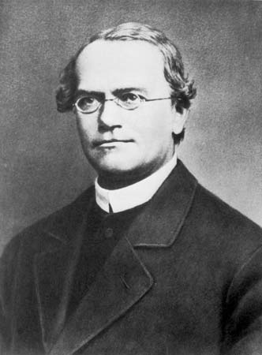
Gregor Mendel
1822-1884
Austrian monk
Studied science
Best known for studies
involving garden peas
Mendel's ideas were rediscovered in the early
twentieth century. The modern synthesis combined
Mendelian genetics with Darwin's theory of
natural selection.
Notes:
Mendel really was the man. If you don’t agree, google “father of genetics” and his name and picture pop up. He came up with a model to describe inheritance well before the discovery of DNA, chromosomes and genes which is pretty amazing.

Slide 3
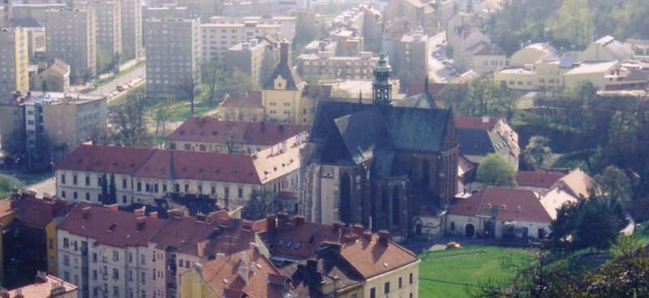
Notes:
Present day photo of where Mendel did his experiments with the garden pea plant.

Slide 4
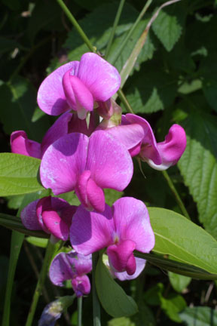
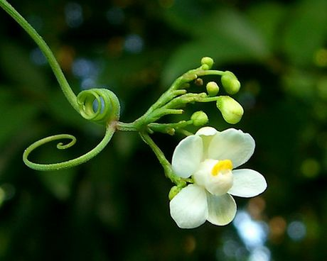
Mendel’s Experiments
A couple of background terms:
True-breeding
Self pollination
Cross pollination
Notes:
True-breeding = plants will produce offspring with the same characteristics as the parent plant when the parent is allowed to self-pollinate.
Self-pollination – plant A pollenates plant A
Cross-pollination – plant A pollenates plant B

Slide 5
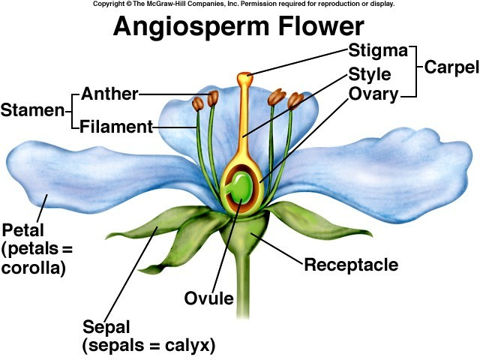
Notes:
Male Parts = Stamen
Female Parts = Carpel

Slide 6
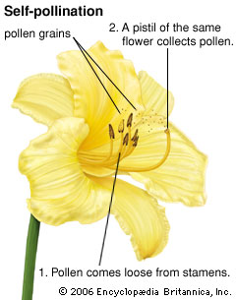
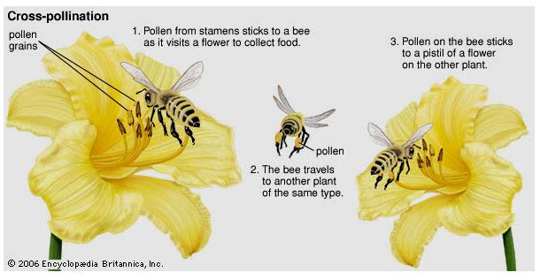

Slide 7
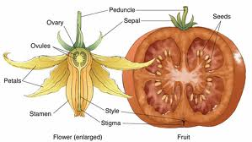
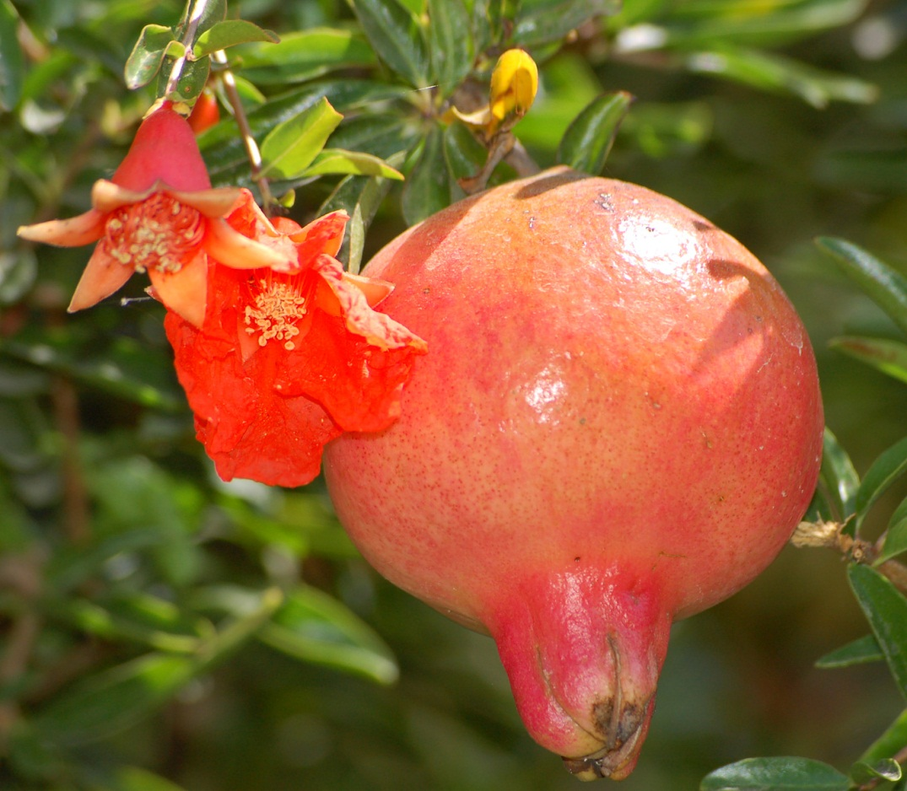
Notes:
What happens when a flower is pollenated? Often time the flower develops into a fruit to aid in seed dispersal. That’s right, anything you eat that has seed in it is a fruit that used to be a flower.

Slide 8
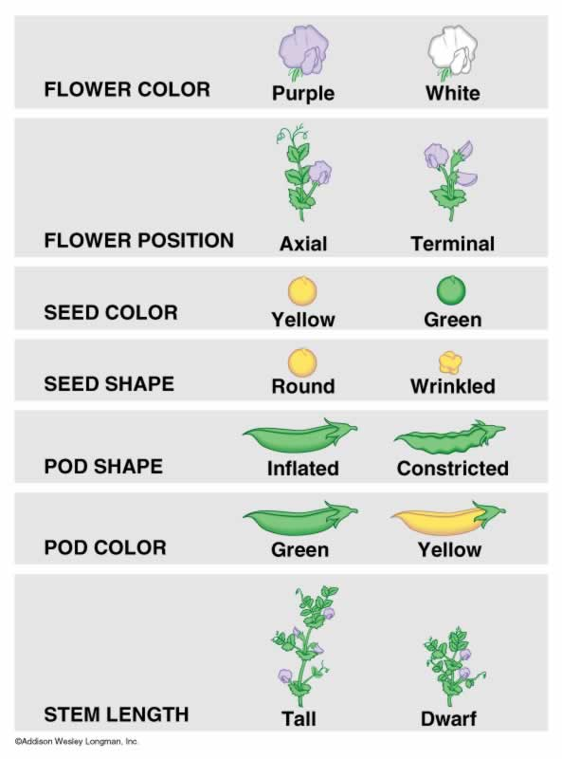
Mendel’s Experiments
The P (parent)
generation
Step One:
  Create true-breeding
  plants using self-
  Pollination

Slide 9
Mendel’s Experiments
The P (parent)
generation
Results:
  Duh…true-breeding
  plants (by definition) only
  produce offspring that
  are the same as the
  parent

Slide 10
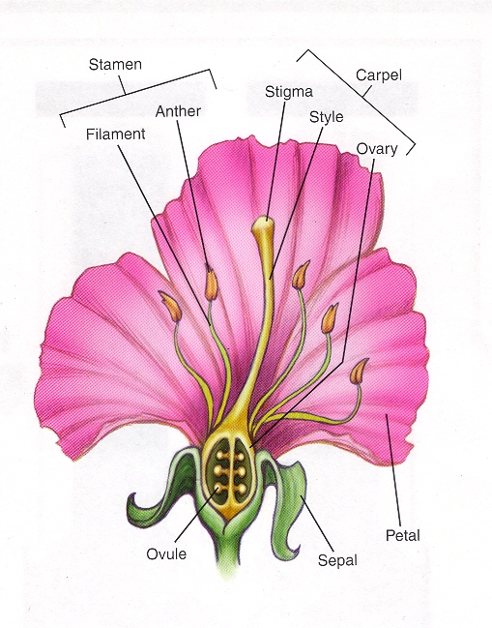
Mendel’s Experiments
Step Two:
  Cross two different P
  Plants to make F1 plants
  P generation (parent)
  F1 generation (1st filial)

Slide 11
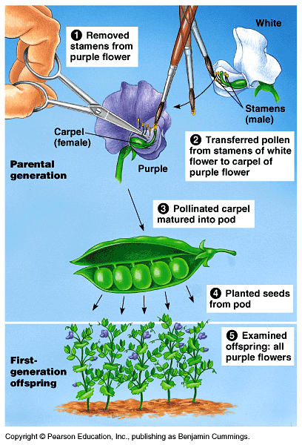
Mendel’s Experiments

Slide 12
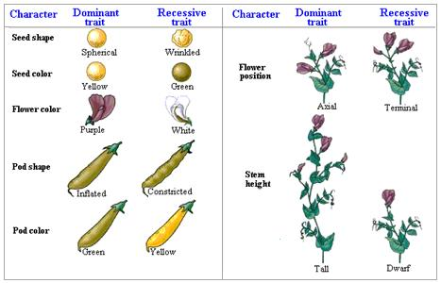
Mendel’s Experiments
Result in the F1 generation:
1 Trait “disappeared”, one was always present
X
X
X
X
X
X
X

Slide 13
Mendel’s Experiments
So this bring up the question: Are the F1 plants just like the P plants?
X
X
X
X
X
X
X

Slide 14
Mendel’s Experiments
Step three: Create an F2 generation –
allow F1 plants to self pollinate.

Slide 15
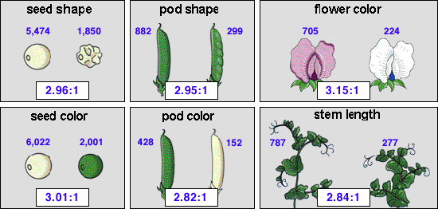
Mendel’s Experiments
Results of F1 cross (F2 generation)– The hidden trait came back!

Slide 16
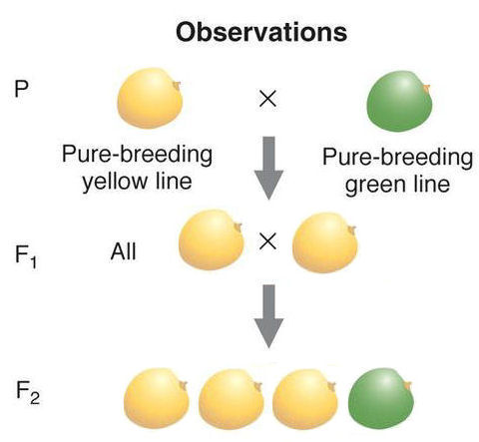
Notes:
Notes: The P generation is true-breeding. They are then cross pollinated to make the F1 generation. The F1 generation is allowed to self pollinate to produce the F2 generation. The results are 100%/0% in the F1 generation and 75%/25% in the F2 generation.

Slide 17
Conclusions:
Dominant vs. Recessive
Each parent contributes one factor for each trait.
There is an interaction between those factors in the offspring.
We now call those “factors” genes.
We now call the different versions of the genes alleles.

Slide 18
Conclusions:
Law of Segregation: Gametes only get one gene allele from each parent
Law of Independent Assortment: A trait is inherited independently from other traits

Slide 19
Genotype
The inherited alleles for a specific trait.
Represented with a single letter.
Capital letter represents DOMINANT trait
Lower case used to represent RECESSIVE trait
Both alleles the same = HOMOZYGOUS
Two different alleles = HETEROZYGOUS
BB
Bb
bb
Notes:
BB = Homozygous Dominant
Bb = Heterozygous
bb = Homozygous recessive

Slide 20
Phenotype
Physical expression of inherited alleles.
Examples:
Green Peas/Yellow Peas
Tall Plant/Short Plant
Brown Eyes/Blue Eyes

Slide 21
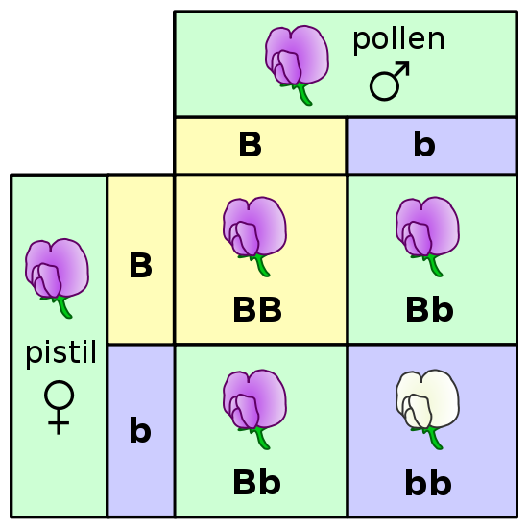
Punnett Squares
Allow you to determine the probable results of a monohybrid cross.
The operative word here is
.
The fact that there are four possible offspring combinations accounted for in this chart does not mean that four offspring will be produced or that any number of offspring will adhere to these ratios exactly.
probability

Slide 22
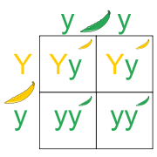
Punnett Squares
First Step: Determine the gametes
Cross a heterozygous yellow pod plant with a green pod plant (Yellow is dominant)

Slide 24
Punnett Squares
First Step: Determine the gametes
FYI:
This is where you are following the Law of Segregation. You set up your parental alleles so that only one gets passed on to the potential offspring.

Slide 25
Punnett Squares
Second Step: Determine the possible offspring

Slide 26
Punnett Squares
Third Step: Determine the phenotype of the offspring

Slide 27
Punnett Squares
Recording/listing the ratios:
Possible Genotypes:
50% Yy
50% yy
Possible Phenotypes:
50% Yellow
50% Green
Possible Genotypes:
1:1 - Yy:yy
Possible Phenotypes:
1:1 - Yellow:Green
Possible Genotypes:
1/2Yy
1/2 yy
Possible Phenotypes:
1/2 Yellow
1/2Green

Slide 28
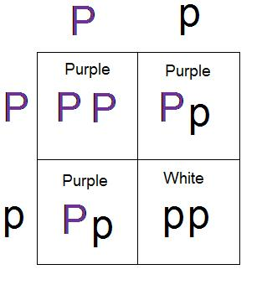
Monohybrid Crosses
First Step: Determine the gametes
Cross two heterozygous purple flowered plants

Slide 29
Monohybrid Crosses
Second Step: Determine the possible offspring

Slide 30
Monohybrid Crosses
Third Step: Determine the phenotype of the offspring

Slide 31
Monohybrid Crosses
Recording/listing the ratios:
Possible Genotypes:
1:2:1 - PP:Pp:pp
Possible Phenotypes:
3:1 - Purple:White
Possible Genotypes:
1/4 PP
2/4 Pp
1/4 pp
Possible Phenotypes:
3/4 Purple
1/4 White

Slide 32
Dihybrid Crosses
Allow you to determine the probable results of a test cross while considering TWO traits at once.
The Laws of Segregation and Independent Assortment will apply.

Slide 33
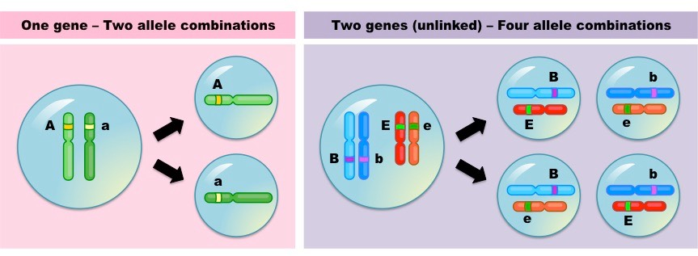
Law of Segregation – split alleles for A (one) trait
Law of Independent Assortment – split alleles for each trait independently

Slide 34
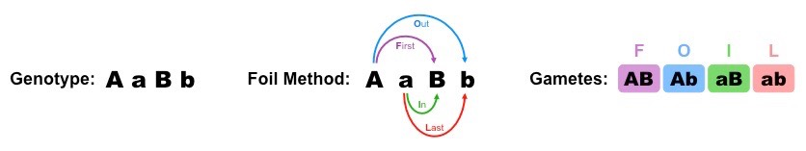
Everything is doubled:
The Gametes

Slide 35

Everything is doubled:
The Offspring
G
g
B
b
G
g
b
b

Slide 36
Dihybrid Cross
BbRr x BbRr
Possible gametes:
BR
Br
bR
br
DAD
MOM
F O I L
Fur Color:
B: Black
b: White
Coat Texture:
R: Rough
r: Smooth

Slide 37
Dihybrid Cross
BbRr x BbRr
DAD
MOM
Step 2: Arrange all possible gametes for dad on the top of your Punnett Square, and mom down the side

Slide 38
Dihybrid Crosses: a cross that shows the possible offspring for two traits
BbRr x BbRr
BR
Br
bR
br
Fur Color:
B: Black
b: White
BR
B
B
R
R
B
B
r
R
B
b
R
R
B
b
R
r
Coat Texture:
R: Rough
r: Smooth
Br
B
B
R
r
B
B
r
r
B
b
R
r
B
b
r
r
Step 3: Fill in the Punnett Square (find the possible genotypes of the offspring)
bR
B
b
R
R
B
b
R
r
b
b
R
R
b
b
r
R
B
b
R
r
B
b
r
r
b
br
b
b
R
r
b
r
r

Slide 39
Dihybrid Crosses
BR
Br
bR
br
BbRr x BbRr
BR
BBRR
BBRr
BbRR
BbRr
Fur Color:
B: Black
b: White
Br
BBRr
BBrr
BbRr
Bbrr
Coat Texture:
R: Rough
r: Smooth
bR
BbRR
BbRr
bbRR
bbRr
br
BbRr
Bbrr
bbRr
bbrr

Slide 40
How many of the offspring would have a black, rough coat?
How many of the offspring would have a black, smooth coat?
How many of the offspring would have a white, rough coat?
How many of the offspring would have a white, smooth coat?
BR
Br
bR
br
BR
BBRR
BBRr
BbRR
BbRr
Br
BBRr
BBrr
BbRr
Bbrr
bR
BbRR
BbRr
bbRR
bbRr
br
BbRr
Bbrr
bbRr
bbrr
Fur Color:
B: Black
b: White
Coat Texture:
R: Rough
r: Smooth

Slide 41
How many of the offspring would have black, rough coat?
How many of the offspring would have a black, smooth coat?
How many of the offspring would have a white, rough coat?
How many of the offspring would have a white, smooth coat?
BR
Br
bR
br
BR
BBRR
BBRr
BbRR
BbRr
Br
BBRr
BBrr
BbRr
Bbrr
bR
BbRR
BbRr
bbRR
bbRr
br
BbRr
Bbrr
bbRr
bbrr
Phenotypic Ratio=
9:3:3:1
Fur Color:
B: Black
b: White
Coat Texture:
R: Rough
r: Smooth

Slide 42
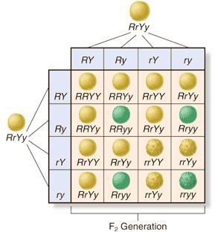
Dihybrid Crosses
First Step: Determine the gametes
Cross a heterozygous yellow pod round plant with a heterozygous yellow pod round plant
(green pods and wrinkled seeds are recessive)

Slide 43
Dihybrid Crosses
Second Step: Determine the offspring
Cross a heterozygous yellow pod round plant with a heterozygous yellow pod round plant

Slide 44
Dihybrid Crosses
Third Step: Determine the ratios
Cross a heterozygous yellow pod round plant with a heterozygous yellow pod round plant

Slide 45
Dihybrid Crosses
Third Step: Determine the ratios
Genotypes:
RRYY - 1
RRYy - 2
RRyy - 1
RrYY - 2
RrYy – 4
Rryy – 2
rrYY – 1
rrYy - 2
rryy - 1
Phenotypes:
Round Yellow
9
Round Green
3
Wrinkled Yellow
3
Wrinkled Green
1

Slide 46
Exceptions to the rule:
What is the rule?
  Medilian inheritance =
    Dominant and Recessive Alleles

Slide 47
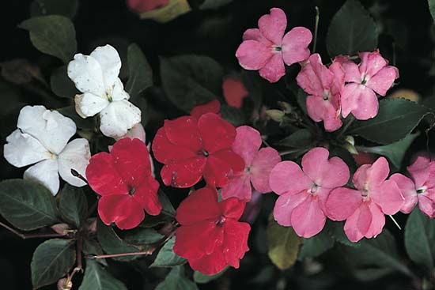
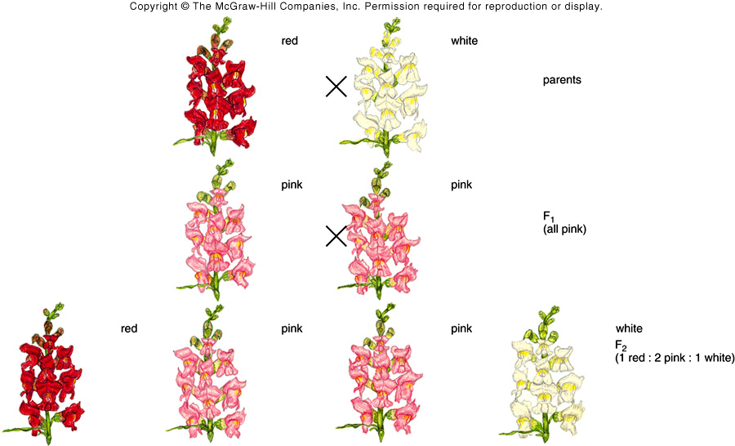
Other Inheritance Patterns
Incomplete Dominance
Notes:
One allele does not “COMPLETELY” dominate the other allele. This results in a blended, 3rd phenotype. Red does not fully dominate white and pink flowers are produced by heterozygotes.

Slide 48
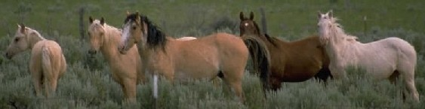

Slide 49
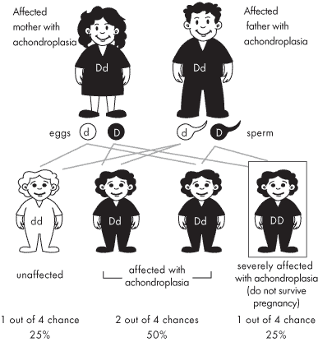
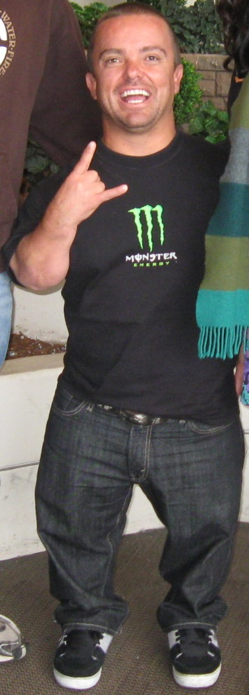
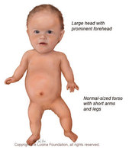

Slide 50
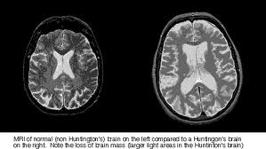

Slide 51
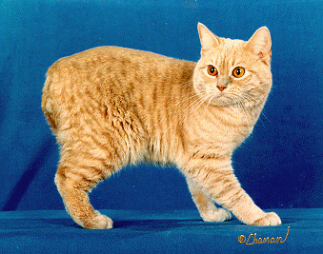
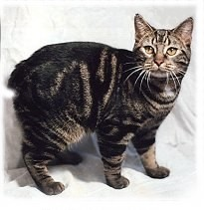
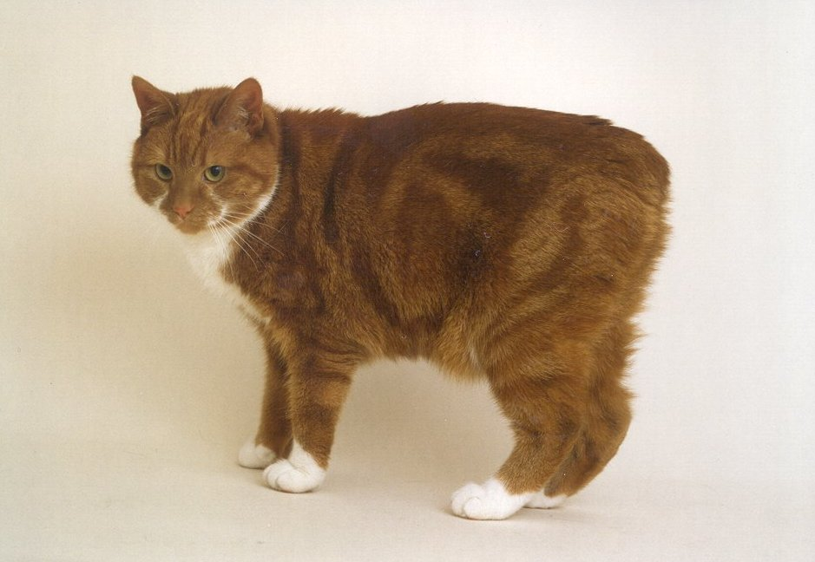
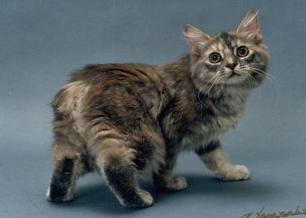

Slide 52
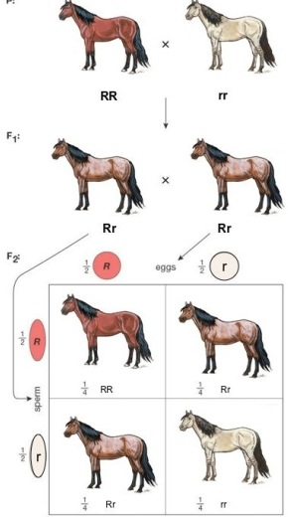
Other Inheritance Patterns
Co-dominance & Multiple Alleles
Notes:
Co-dominance = both alleles are fully expressed. A bit confusing… A red horse and a white horse produce a ROAN horse. At first, ROAN appears to be a blend between red and white but when you look closely, a ROAN horse has some hairs that are completely red and others that are completely white. Therefore, both traits won the battle to be expressed.
A trait with more than two different alleles is called multi-allelic.

Slide 53
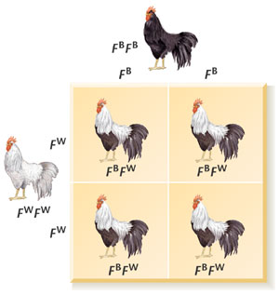
Other Inheritance Patterns
Co-dominance & Multiple Alleles

Slide 54
Example: blood type
1. type A = I^{A}I^{A} or I^{A}i
2. type B = I^{B}I^{B} or I^{B}i
3. type AB = I^{A}I^{B}
4. type O = ii
Notes:
Note that the I with an A and the I with a B are both capital letters and, therefore dominant traits. The trait for type O blood is the “i” allele and is recessive to both A and B blood alleles.

Slide 55
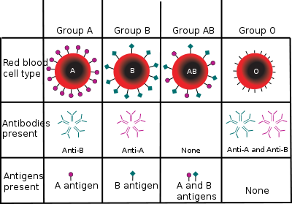

Slide 56
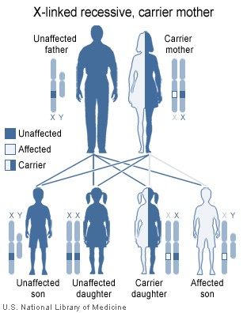
Other Inheritance Patterns
Sex-Linked Traits

Slide 57
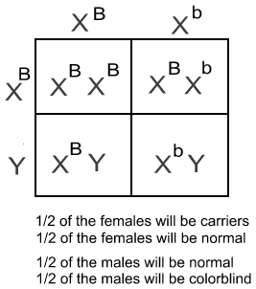
Other Inheritance Patterns
Sex-Linked Traits

Slide 58
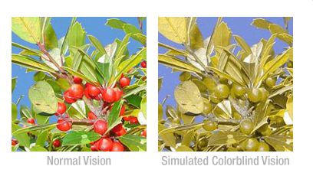
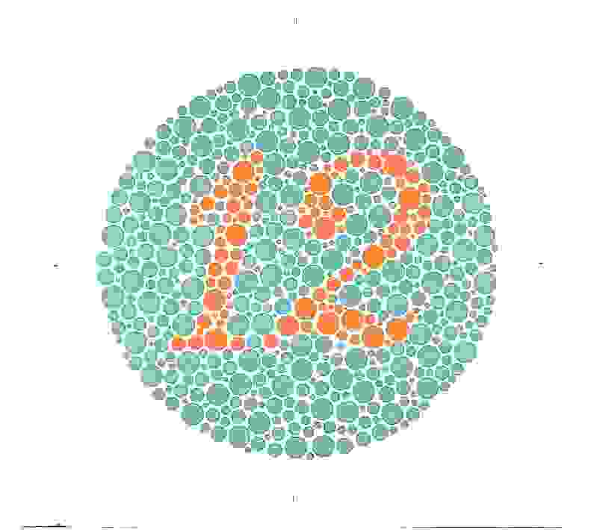
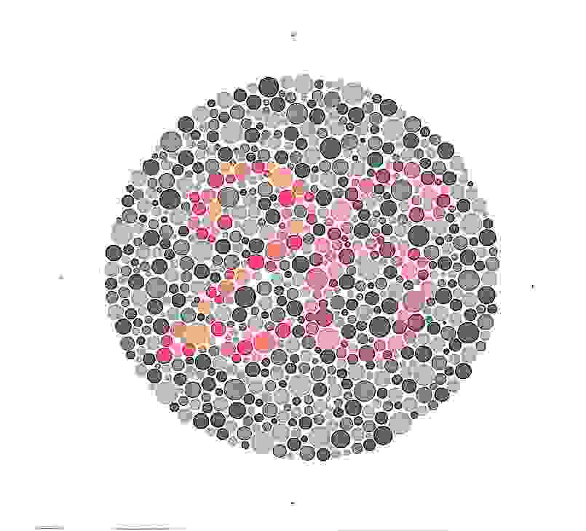
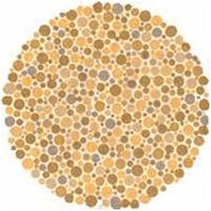
Other Inheritance Patterns
Sex-Linked Traits
10% of males & .04% of females are colorblind

Slide 59
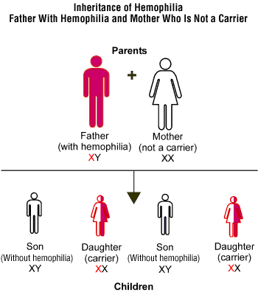
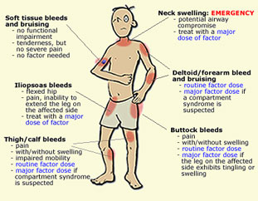

Slide 60
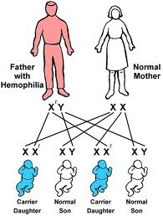

Slide 61
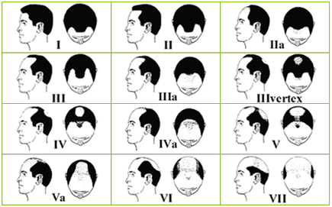

Slide 62
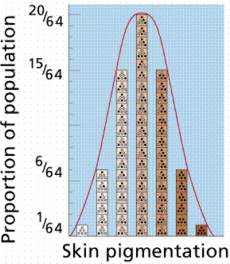
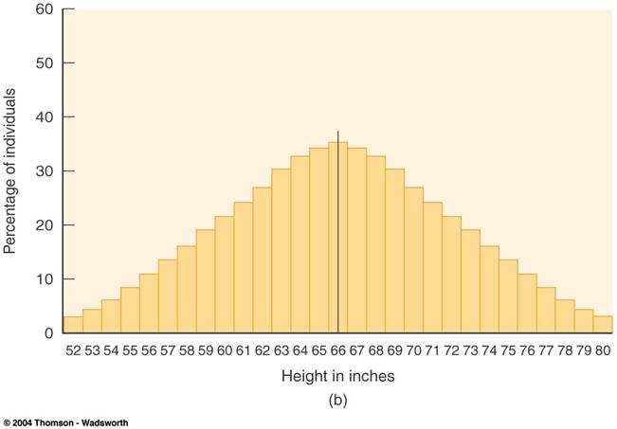
Polygenic Traits
Multiple genes

Slide 63
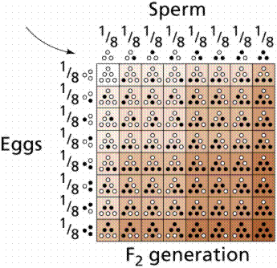

Slide 64
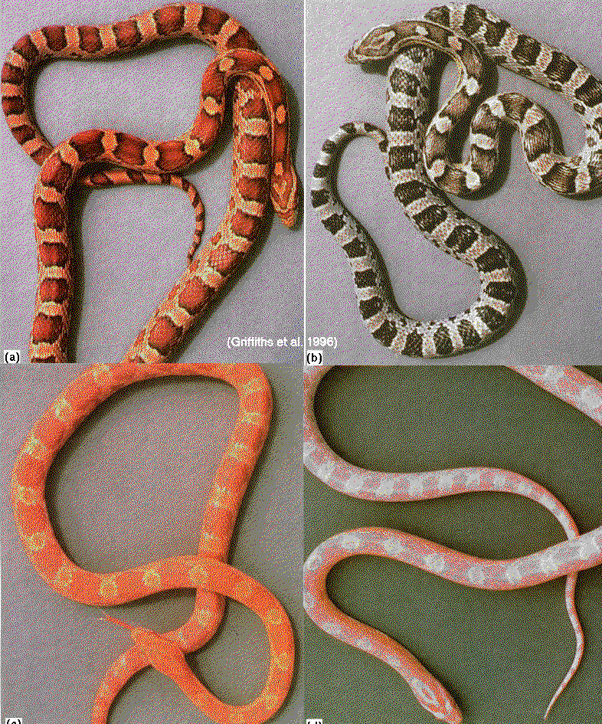

Slide 65
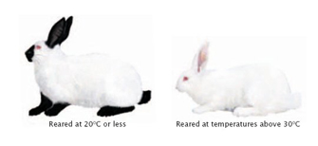

Complex Characters
Environmental influences

Slide 66


Slide 67
Epistasis
When one gene influences another
Example: Albinism in horses

Slide 68

B = Brown
b= tan
C = deposit
  pigment
c = no pigment deposition

Slide 69



Slide 70


Slide 71


Slide 72




Slide 73
Pedigrees
Use: Tracing inheritance through multiple generations

Slide 74

Pedigrees

Slide 75


Methemoglobinemia

Slide 76



Slide 77



Slide 78


Slide 79


Slide 80


Slide 81


Slide 82


Slide 83


The Cure: Methylene Blue

Slide 84

Hypertrichosis

Slide 85


Slide 86

Figure 1. Pedigree of Doberman dogs carrying the canarc-1 mutation. Homozygous individuals indicated by filled symbols and unaffected heterozygotes with dotted symbols (females as circles, males as squares).

Slide 87



Slide 88


Slide 89


Slide 90


Slide 91


Slide 92

Pedigree 4

