Slide 1
Predicting Products

Slide 2
Synthesis
If you see 2 single elements then these elements will combine to form 1 compound. This is known as a synthesis reaction.
Example
Na + Cl₂ → ?

Slide 3
Synthesis
Because they are just 2 lone elements they will combine. (Na has a charge of +1 & Cl has a charge of -1)
Na + Cl₂ → NaCl

Slide 4
Synthesis
After writing the products and balancing the charges (like you did in unit 6), then you should balance the equation.
2Na+ Cl₂ → 2NaCl

Slide 5
Decomposition
If you see a compound, the compound will break apart into the individual elements or smaller compounds, this is known as decomposition.
Example:
H₂O→ ?

Slide 6
Decomposition
Because there is no other reactant the single reactant decays into its original parts.
H₂O→H₂ + O₂

Slide 7
Decomposition
After determining the reactants, double check for super 7 elements. They should have a 2 subscript if they are by themselves. Once they are checked balance the reaction.
2H₂O → 2H₂ + O₂

Slide 8
Single Replacement
If you see a single element and a compound, then the single element will displace one of the elements in the compound. This is known as a single displacement.
Example
Al + Fe₂O₃ → ?

Slide 9
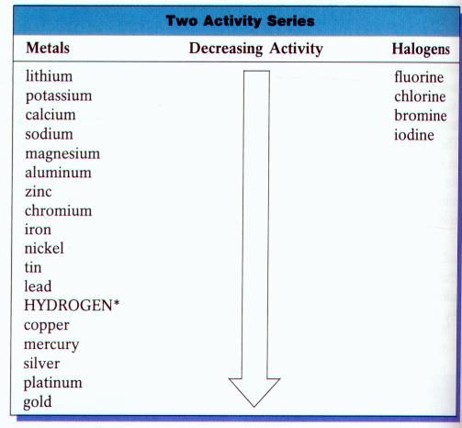
Check the series…

Slide 10
Single Replacement
To determine which element is replaced in the reaction, establish whether the single element is a metal or a non-metal. Metals will replace the metal in the compound and non-metals will replace the non-metal in the compound. Be sure to balance the charges on the newly formed compound. The new single element will not have a subscript unless it is part of the super 7.
In this reaction aluminum is a metal so it will replace iron.
Al + Fe₂O_{3 →} Fe + Al₂O₃

Slide 11
Single Replacement
After predicting the product balance the reaction.
2Al + Fe₂O_{3 →} 2Fe + Al₂O₃

Slide 12
Double Replacement
If you see two compounds then the elements in the compounds will switch. This is known as double replacement.
Example
Ca(CO₃) + Na(CN) →

Slide 13
Double Replacement
To determine which components switch, you must identify the parts as either metal or nonmetal, cation or anion. Metals will replace metals. Nonmetals will replace nonmetals. Cations will replace cations. Anions will replace anions.
In this reaction calcium is a metal and sodium is a metal, therefore these elements will switch with one another. The charges will need to be balanced in the two newly formed compounds.
Ca(CO₃) + Na(CN) → Ca(CN)₂ + Na₂(CO₃)

Slide 14
Double Replacement
After completing the products, balance the equation.
Ca(CO₃) + 2Na(CN) → Ca(CN)₂ + Na₂(CO₃)

Slide 15
Combustion
If you have carbon and hydrogen compound reacting with oxygen, it is known as combustion.
Example:
C₂H₄ + O₂→ ?

Slide 16
Combustion
A combustion reaction will always produce carbon dioxide and water.
C₂H₄ + O₂ → CO₂ + H₂O

Slide 17
Combustion
After completing the reaction, balance the equation.
C₂H₄ + 3O₂ → 2CO₂ + 2H₂O

