Slide 1
Meiosis Gamete Formation
Why are siblings sometimes so much alike and other times so different?
How is the information from parents distributed to offspring?
Version January 2018
Notes:
Not meant to show to students.

Slide 2
Teacher notes
We use these symbols on student slides to communicate to them the following actions:
Work in research groups
Think
Share
Write down
Notes:
Not meant to show to students.

Slide 3
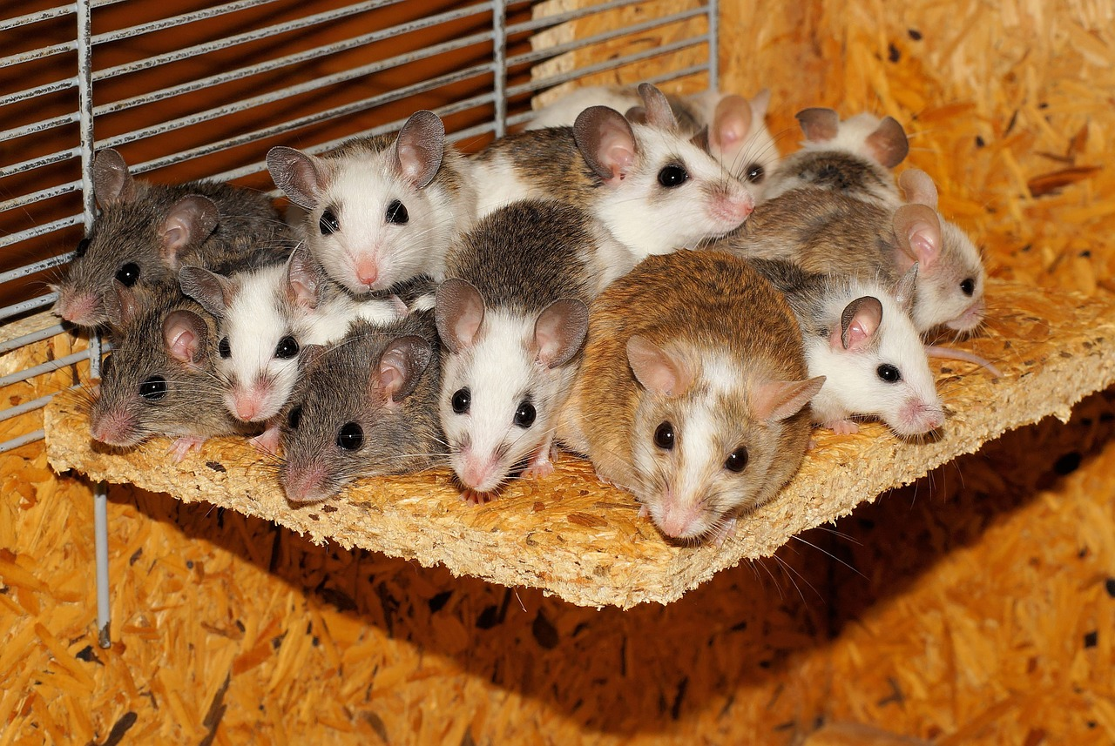
We have reasoned that fitness is the ability to survive, reproduce and pass on traits.
From Natural Selection (How traits in a population change over time) we have reasoned that offspring tend to resemble the parents and thus will also have fitness. If offspring tend to resemble their parents, can we then reason that siblings should also resemble each other?
Notes:
TEACHER NOTES: This is for the transition from Sexual Selection to the Blue Loop. You may want to hide the words and only show the pictures while you make this transition.
To help enhance the coming phenomenon, have students share out their own experiences with looking or not looking like other members of their family. Take a poll: who knows someone who looks just like others in their biological family? Who knows someone who looks nothing like others in their biological family? OK, Now we will take a look at a family from the United Kingdom.
SOURCES: http://maxpixel.freegreatpicture.com/Mice-Security-Mastomys-Family-Community-Together-800875

Slide 4
18 year-old Lucy (left) and Maria (right) are twins. They live in the UK.
Social media is abuzz. The family has been accused of making up the story for attention and profit. People say biological twins could not be this different. One of them must be adopted.
Notes:
TEACHER NOTES:
We introduce Lucy and Maria and the controversy surrounding them and their family.
SOURCES:
https://www.topmagazin.sk/wp-content/uploads/2015/03/black-white-skin-twin-sisters-lucy-maria-aylmer-12.jpg
Video of Lucy and Maria
https://theweeklyobserver.com/twin-sisters-born-one-black-one-white/29388/

Slide 5
18 year-old Lucy (left) and Maria (right) are twins. They live in the UK.
What do you think?
Is it possible for Lucy and Maria to be biological twins - Why do you think it is possible? or
Why is it NOT possible?
Explain your position in Doodle Box A
Any additional information you would like to have?
Notes:
TEACHER NOTES:
We ask students to think about the possibility of Lucy and Maria being twins. Are they? How could this be? Students record their ideas in Doodle Box A.
We then ask if they would like more information.
SOURCES:
https://www.topmagazin.sk/wp-content/uploads/2015/03/black-white-skin-twin-sisters-lucy-maria-aylmer-12.jpg
Article
Video of Lucy and Maria
https://theweeklyobserver.com/twin-sisters-born-one-black-one-white/29388/

Slide 6
Because you asked…
Mom is ½ Jamaican, ½ Caucasian.
Dad is Caucasian.
Notes:
TEACHER NOTES:
If students have questions about the twins parents, you can post this slide.

Slide 7
Biological Twins?
POSSIBLE
NOT POSSIBLE
Notes:
TEACHER NOTES:
If students are short on ideas have them pair share before reporting out to the class. Record their ideas in the appropriate box in the slide. Hopefully some ideas will surface about heredity, genes, or DNA being passed from parents to offspring. If not, point out the class Natural Selection Model and the model statement that refers to traits being heritable and so offspring tend to resemble their parents. (Your student’s statement will not be worded the same but should have the same meaning) This discussion leads into the question: How exactly does the hereditable information get from the parents to the offspring?

Slide 8
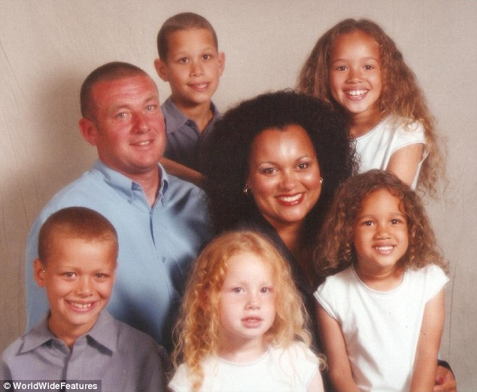
If parents pass on their traits to their offspring, then the way that Lucy and Maria turned out depends on the information they got from their parents.
Let’s figure out how that works.
How exactly does the hereditable information get from the parents to the offspring?
Notes:
TEACHER NOTES:
Depending on your students’ ideas you may all agree, disagree or be at an impasse. Either way you will need to make sense of how hereditable material is passed from parent to offspring before being able to fully explain this phenomenon. We end this learning segment with our new driving question: How exactly does the hereditable information get from the parents to the offspring?
If students ask this question, but with different wording, please use their wording for the driving question.
SOURCES:
http://i.dailymail.co.uk/i/pix/2015/03/01/2612C4A900000578-2974869-Family_line_The_twins_mother_Donna_is_half_Jamaican_and_their_fa-a-12_1425253983608.jpg

Slide 9
How does the hereditable information get from the parents to the offspring?
Record your ideas in Doodle Box B
Notes:
TEACHER NOTES:
Have students think and then record their ideas in Doodle Box ___.
They will then either work in pairs or groups to share their ideas and report to the class.
The next slide has a place to post their ideas, however a consolidated list from all classes should be posted on the white board or on a poster the student thinking visible.
SOURCES:
http://i.dailymail.co.uk/i/pix/2015/03/01/2612C4A900000578-2974869-Family_line_The_twins_mother_Donna_is_half_Jamaican_and_their_fa-a-12_1425253983608.jpg

Slide 10
How does the hereditable information get from the parents to the offspring?
[class initial model ideas]
Notes:
TEACHER NOTES:
Students can work in their groups with whiteboards to consolidate their ideas and then share out, or you may have the students pair, share and then call out their ideas.
It is important to have DNA on the list to help motivate the next learning segment. This shouldn’t be too difficult since DNA is a very familiar word.
Sample Statement: “DNA carries the heredity stuff”
Post these initial ideas on a poster or whiteboard and in the provided slide.
If these ideas are written on a poster, it will be easier to compare them in to later ideas in learning segment 3

Slide 11
DNA!
To help us figure out how DNA is passed from parents to offspring we will think of DNA in its tightly coiled form.
The Chromosome
Notes:
TEACHER NOTES: Students know that heredity has something to do with DNA. We are going to “black box” how DNA works and what it is, for another triangle, for now we want to figure out how it is passed on to offspring. It is helpful to think of DNA in it’s tightly coiled form, the chromosome. Some students may know this, so the slide is animated to give think time and hopefully have a student share the answer. At this point, all we need to figure out, is that the chromosome is tightly coiled DNA and it carries hereditable information. We will make sense of DNA in a later triangle.
SOURCES:
Https://commons.wikimedia.org/wiki/File:Human_chromosome_09_from_NCBI_Bookshelf.jpg
DescriptionEnglish: Ideogram of human chromosome 9.
Date1998SourceNCBI Bookshelf "Genes and Disease" (1998-). Available from: http://www.ncbi.nlm.nih.gov/books/NBK22266/AuthorNational Center for Biotechnology Information

Slide 12
How do parents pass on their Chromosomes (DNA)?
The pipe cleaners in the bag represent the chromosomes of two normal, healthy parents of a species.
Separate the chromosomes (tightly Coiled DNA) into the two parents.
Line up the chromosomes of each parent in an organized way inside two circles on your whiteboard.
Notes:
TEACHER NOTES:
This activity can be done in pairs or in groups, depending on how many Heredity Kits you have. To help us figure out how parents pass on their chromosomes we will work with pipe cleaners from the Heredity Kit. The Heredity Kits contain 3 pairs of different size pipe cleaners in 2 different colors One color represents Mother and the other color represents the father.
Students first draw 2 circles at the top of their whiteboard
Ask students to separate the chromosomes into 2 parents. Or you can ask students to group the chromosomes into 2 distinct groups (that usually gets the chromosomes into color groups)
Next student organize the chromosomes in the 2 circles. The chromosomes should be organized in matching pair length: 2 long, 2 medium, 2 short. (one set has a short and super short, more on that later)
Don’t worry too much about how the chromosome pairs are organized in the circle, that main idea is that the students figure out that the chromosomes come in pairs. Check each group to see that they have the chromosomes separated and organized in their 2 circles.

Slide 13
Which parent is the father and which is the mother?
How do you know?
Label the circles on your white board
Notes:
TEACHER NOTES:
Give students time to think about this. Some will know right away and others will need some time to think about why. The chromosome set with the short and super short chromosome is the father. This is because males have 1 X chromosome and one Y chromosome. Two different chromosome that are 2 different sizes. Females have 2 X chromosomes. They are the same and thus the same size.

Slide 14
Now that you have the parents, figure out how to make a viable (healthy, normal) baby.
Make another circle on the whiteboard and label it “BABY”
Decide what chromosomes the parents give the baby and place them in the circle.
Notes:
TEACHER NOTES:
Students play with the chromosomes to come up with a combination that will make viable baby. LET THEM FAIL! It is OK, they’re only pipe cleaners. Once a group thinks they have a baby have them put up their red cup or some other signal so you know to come check. Try to not let other groups “see” the viable baby, we want everyone to figure this out for themselves. There are several possible combinations, but as long as there is a long, medium, and short from the mother and a long, medium, and short from the father, they have a baby. Ask students if they have a boy or a girl, and how they know. Students then draw the baby chromosomes on their Doodle.
Students will complete this activity at different times, so challenge the early finishers with making a baby with the opposite sex, or can they make a different baby out of the same set of chromosomes?

Slide 15
Lets do this again, but with a twist
Remove the baby chromosomes and put them back into the appropriate parent circles.
This time, use the poker chips to decide which of the Fathers long chromosomes will go to the baby. Use the other poker chip to decide which of the Mother’s long chromosomes will go to the baby. Repeat for the other 2 pairs of chromosomes.
Look around at other babies. Do they look the same? Why or Why not?
Notes:
TEACHER NOTES:
We’re going to make another baby but this time we will let chance decide. We do this to emphasize that the chromosome from each pair, contributed to the baby, is totally random. 2 different people take the 2 different poker chips. Decide who will represent the Mother and who will represent the Father. Together, they toss and catch. If you represent the Mother and flipped an A, take the long A from the Mother Circle and contribute it to the baby. The Father representative does the same. Then both repeat for the medium and then the short chromosomes.
Not only does this show that the contributed chromosome from each pair is at random, it also shows that each chromosome in each pair has a 50/50 chance of being contributed.
Model Idea: Which chromosome given from a pair is random.

Slide 16
Now, go back to the pipe cleaners and re-build Mom & Dad.
Notice the pairs of chromosomes
Mother
Father
Draw the chromosomes (color, size, letter,) for both the mother and the father in the appropriate circles on your M Diagram Doodle and LABEL.
Notes:
TEACHER NOTES:
Students rebuild the Mother and the Father, as we prepare to do this again, but we will now record the process on our M Diagram Doodle and add science terms.
The purpose of this the Diagram Doodle is for the students to have a nonlinguistic representation of gamete development. The diagram does not stand alone, but helps up to visualize the model statements.

Slide 17
A Viable Baby
Or

Slide 18
How did you do it ?
What criteria or rules did you use to decide how to make a viable baby?
Record your ideas in Doodle Box C
Work in your groups to consolidate your ideas and prepare to share out.
Notes:
Students record their ideas in Doodle Box C. In their groups students consolidate their ideas and then share out as the ideas are recorded on the next slide.

Slide 19
How does the hereditable information get from the parents to the offspring? In other words what criteria or rules did you use to make a viable baby? These are your model ideas
[List class ideas here]
Notes:
TEACHER NOTES:
Students work in groups and then each group shares out their “rules.” These will be shaped into model ideas.
Compare the initial ideas with the new ideas and revise as needed.
Don’t be to concerned if all the ideas are fully developed at this point. We will work on developing these ideas throughout the learning segment.
Student examples
Baby must have 6 chromosomes
Gets half from each parent
X from dad = girl, Y from dad = boy
Baby must have 2 of each kind of chromosome
Parents give one from each pair.
Which one the parent gives is random.

Slide 20
Lets think about the chromosomes
Do you think it matters how many chromosomes an organism has?
Share your ideas with your partner.
Would you like more information?
Notes:
TEACHER NOTES:
Quick share pair, the next slide shows data

Slide 21
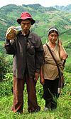
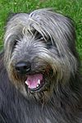
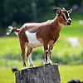
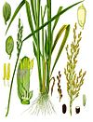
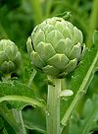
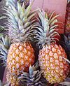
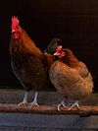
Chromosome count in different organisms
Organism | Total number of chromosomes
Human | 46
Dog | 78
Goat | 60
Yellowfever mosquito | 6
Rice | 24
Snail | 24
Artichoke | 34
King crab | 208
Coton | 50
Mouse | 40
Pinapple | 50
Tasmanian devil | 14
Chicken | 78
Honey bee | 32
Grey wolf | 78
Notes:
TEACHER RESOURCES:
Have students look for patterns in the data.
They will notice that different organisms have different numbers of chromosomes but all the organisms have an even number of chromosomes.
SOURCE:
https://en.wikipedia.org/wiki/List_of_organisms_by_chromosome_count

Slide 22
Chromosome count in different organisms
What pattern do you notice?
What do they all have in common?
They all have an even number of chromosomes, they in come in pairs
Model Revision?
Notes:
TEACHER RESOURCES:
If students only notice that most have different numbers of chromosomes, then ask: “If the number of chromosomes is different for different organisms then what is the pattern?” It might be helpful to show the “Chromosome Count” slide again. While students think.
The slide is animated to allow for wait time.
There are a couple of slides that prompt a model revision at the end of this learning segment. If it makes more sense for your students to revise and add ideas after each or some of the slides, then do what is best for your students.
Each time a revised idea is introduced it will be noted in the teacher notes.
Model Idea: Sexually reproducing organisms have pairs of chromosomes.

Slide 23
How does the hereditable information get from the parents to the offspring? In other words what criteria or rules did you use to make a viable baby?
[List class ideas here]
Notes:
TEACHER NOTES:
It is important that the Model Statements are in your students words and not necessarily the same as stated here. In other words ☺ the ideas should be the same but not the actual words.
Model Idea: Sexually reproducing organisms have pairs of chromosomes.

Slide 24
Back to the pipe cleaners….
What actually carries the chromosomes to the baby?
Record your idea in Doodle Box D
The sex cell
Also known as the gamete
Notes:
TEACHER NOTES: Now that we made sense of the important parts of this model;1/2 of the chromosomes come from each pair of each parent and that it is random, we can focus on what this process really is, gamete formation. This slide and the ones that follow are animated to allow for think time. Most students have heard of these terms before so we let them think and pair share if they are struggling, before discussing the answer as a class.
This information also helps us with the simple, short answer to our driving question:
How does the hereditable information get from the parents to the offspring?
Gametes!

Slide 25
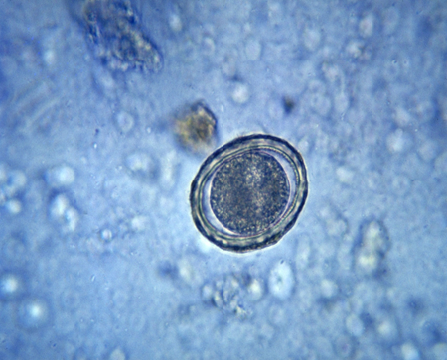
What carries the chromosomes from the female to the offspring?
Record your idea in Doodle Box E
Egg
How many chromosomes are in an egg compared to the parent cell?
½
Haploid (1 from each pair…1 long, 1 medium & 1 short
Draw the chromosomes (color, size, letter,) for the female gamete in the appropriate circle on your Diagram Doodle and LABEL.
Notes:
TEACHER NOTES:
Students rethink the process of “making a baby” but we break it down and ask some new questions: what actually carries the chromosomes? How many chromosomes are in the egg compared to the parent? We also introduce the term haploid now that we understand the concept of having ½ the number of chromosomes. We introduce this term so we can use it distinguish between the sex cells and somatic (body) cells.
We add to our M Diagram Doodle
This is the place to really define the following model ideas.
Model Ideas more fully developed:
Each parent gives half of their chromosomes to each gamete
(Offspring has ½ of its chromosomes from the mother and ½ from the father.)
Gametes have ½ the chromosomes of the organisms

Slide 26
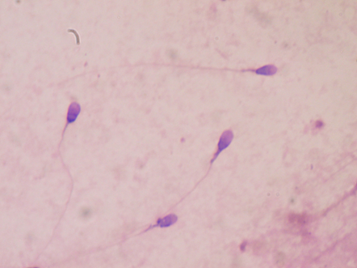
What carries the chromosomes from the male to the offspring?
Record your idea in Doodle Box F
Sperm
How many chromosomes are in a sperm compared to the parent cell?
½
Haploid (1 from each pair…1 long, 1 medium & 1 short
Draw the chromosomes (color, size, letter,) for the male gamete in the appropriate circle on your Diagram Doodle and LABEL.
Notes:
TEACHER NOTES:
Students rethink the process of “making a baby” but we break it down and ask some new questions: what actually carries the chromosomes? How many chromosomes are in the egg compared to the parent? We also introduce the term haploid now that we understand the concept of having ½ the number of chromosomes. We introduce this term so we can use it distinguish between the sex cells and somatic (body) cells
We add to our M Diagram Doodle
Model Ideas more fully developed:
Each parent gives half of their chromosomes to each gamete
(Offspring has ½ of its chromosomes from the mother and ½ from the father.)
Gametes have ½ the chromosomes of the organisms

Slide 27
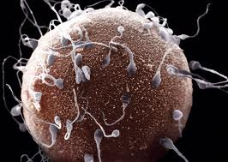
It’s different for males and females.

Slide 28
What is it called when the egg and sperm meet?
Record your idea in Doodle Box G
Fertilization
Notes:
TEACHER NOTES:
This is a reminder that the when the chromosomes come together (sperm meets egg) we call it fertilization. Students can also label this on their M Diagram Doodle
If students don’t already have the idea in their model that each parent contributes one chromosome from each pair, then the following conversation will help with that idea development.
Take a look at the chromosomes. There are 3 from the father and 3 from the mother, but is it important which 3. Can you have 2 short and one long?
Model Ideas more fully developed:
Each parent only contributes one chromosome per pair to each (gamete) offspring.

Slide 29
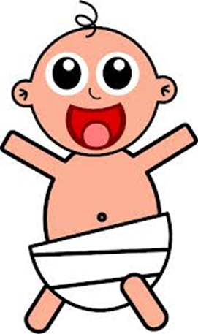
What is created when the egg and sperm meet?
Record your idea in Doodle Box H
Zygote → Baby
How many chromosomes are in a zygote compared to an egg or a sperm?
½ + ½ = 2/2
Diploid (two for each pair..2 long, 2 medium & 2 short)
Draw the chromosomes (color, size, letter,) for the zygote in the appropriate circle on your Diagram Doodle and LABEL.
Notes:
TEACHER NOTES:
This is a reminder that when the chromosomes come together they find their match, pair up and now we have a zygote. The equation helps reinforce the idea that the number of chromosomes needs to be cut in half to make a gamete so when the 2 gametes come together the new organism has a complete set of chromosomes and not double what the parents had. (we will discuss this again in the next learning segment) We also introduce the term zygote.
Before showing the next slide it is important that students have made an attempt to sketch the appropriate chromosomes in the appropriate circles and that chromosomes and circles are correctly labeled.

Slide 30
Gamete and Zygote Formation
Father
Mother
Fertilization
Egg
Sperm
Zygote
Notes:
TEACHER NOTES:
This slide is for students to check to make sure they have similar sketches and labels on their M Doodle Diagram. Before showing the animations it is important that students have made an attempt to sketch the appropriate chromosomes in the appropriate circles and that chromosomes and circles are correctly labeled

Slide 31
Model Revision
What have we figure out?
What carries the hereditable information from parent to offspring?
Gametes
The process of making gametes is called Meiosis
We have figure out some key details to making gametes.
What do we add/delete/ revise in our model?
Notes:
TEACHER NOTES:
We still have a few key ideas to add to our model, but now is a good time to revise what we do have. We also have an opportunity to have students name their model. We call this model Gamete Formation (Meiosis), but students should give it a name that makes sense to them.
Student examples: How to make eggs and sperm or How to make sex cells.

Slide 32
Model Revision How does the hereditable information get from the parents to the offspring?
Notes:
TEACHER NOTES: Now is when we want to look back at our last model revision and revise again! The students’ model statements do not have to match the one provided but the should embody the same ideas.
Model Ideas up to this point:
Sexually reproducing organisms have pairs of chromosomes.
Each parent gives half of their chromosomes to each (gamete)offspring
(Offspring has ½ of its chromosomes from the mother and ½ from the father.)
Gametes have ½ the chromosomes of the organisms
Each parent only contributes one chromosome per pair to each (gamete) offspring.
Which chromosome given from a pair is random.
Traits are usually inherited independently from one other (independent assortment) (this idea can be teased out by looking at the 2 statements: Each parent only contributes one chromosome per pair. AND Which chromosome given is random. From these 2 statements we can infer that the traits passed on are not all linked together, But are (usually) inherited independently of each other).

Slide 33
Let’s use our model to make sense
of a few more things
WHY do we need to make these special gamete cells
Use our model and write your thoughts in Doodle Box I
Share your ideas with your partner
+
46
46
=
92
Notes:
TEACHER NOTES:
We now turn our thoughts to why we need the process of gamete formation. In this slide we focus on idea that the # of chromosomes is cut in half in order to meet with another half to make a whole. If reproductive cells didn’t so this then each time a new organism was made it would double the number of chromosomes.

Slide 34
WHY does each person have two of each kind of chromosome? (2 long, 2 medium, 2 short)
Write your ideas in Doodle Box J
Share your ideas with your partner
x
MOM
DAD
BABY
A B
A B
A B
A’ B’
A’ B’
A’ B’
A A’
A B’
B B’
Notes:
TEACHER NOTES:
Use this pare share and animated diagram to help make sense of the idea that we all have 2 of each kind of chromosome because we got one from our Mom and one from our Dad.
Where did they get their chromosomes? One from their Mom and one from their Dad.
And it is completely random which chromosomes you receive. The colors of the Baby’s chromosomes will always be one red and one blue, but the baby could have long: B, A’ , or A, B’, or B, B’
You can also discuss what sex the baby is: Male
To help students focus on the sense making, change the color of the chromosomes in this slide to match your pipe cleaner chromosomes. (This is especially helpful for language learners)

Slide 35
When scientists work with organisms that have several pairs of chromosomes, they number the pairs.
Are any of the chromosome pairs below
exactly the same? Why or why not?
x
MOM
DAD
BABY
1A 1B
2A 2B
3A 3B
1A’ 1B’
2A’ 2B’
3A’ 3B’
1A 1A’
2A 2B’
3B 3B’
Notes:
TEACHER NOTES:
Now we focus on the idea of numbering the pairs of chromosomes which gives them a specific name and makes it easier to identify them. (We first used long medium and short to describe the chromosomes so the sense making could focus on the process and not terminology, but now we can add the common science labels) The next slide will show a human karyotype with numbered chromosome pairs.
We also ask if any of the chromosome pairs are exactly the same. They can’t be the same because they came from different parents.
To help students focus on the sense making, change the color of the chromosomes in this slide to match your pipe cleaner chromosomes. (This is especially helpful for language learners)

Slide 36
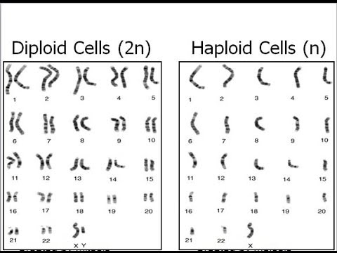

Slide 37
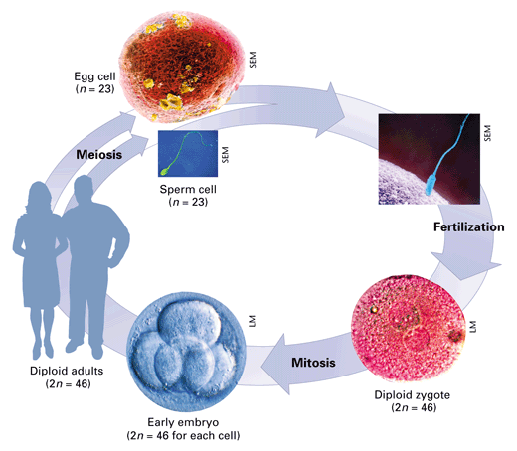

Slide 38
Organism | Chromosome # (Diploid)
Buffalo | 60
Lion | 38
Llama | 74
Donkey | 62
Horse | 64
Camel | 74
Cow | 60
Tiger | 38
Cabbage, Broccoli, Cauliflower | 18
Cockroach | 23 or 24
Chimpanzee | 48
Earthworm | 36
Kangaroo | 16
Mango | 40
Human | 46
How many chromosomes do we have?

Slide 39
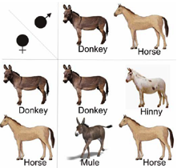
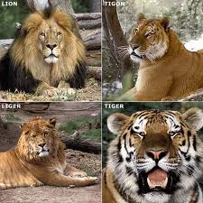
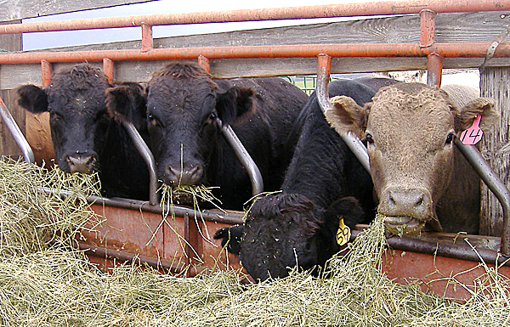
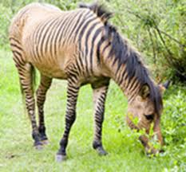
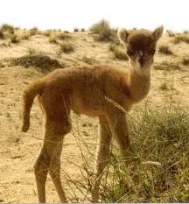

Slide 40
Let’s take a closer look at the chromosomes that have to get copied and split during mitosis…

Slide 41
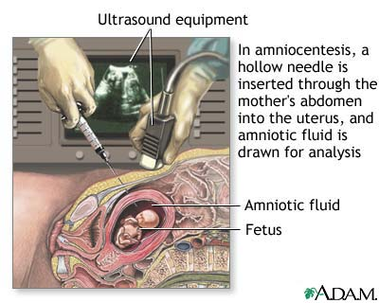
We can look at your chromosomes before you’re born.

Slide 42
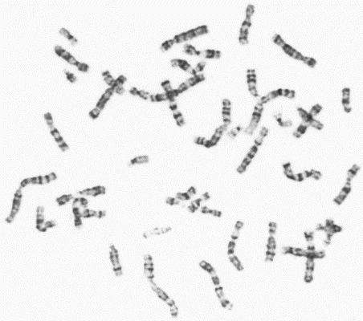
Karyotype

Slide 43
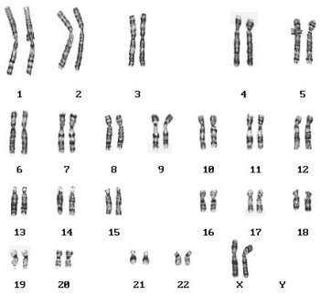

Slide 44
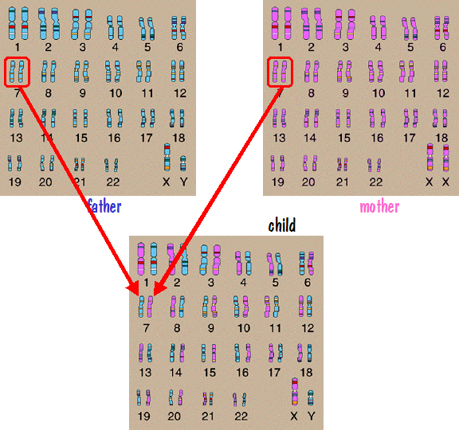

Slide 45
How do we know which chromosome is which?

Slide 46
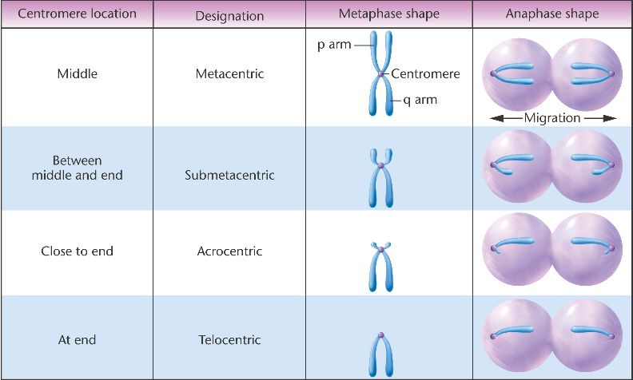
Location of the centromere helps identify chromosomes.

Slide 47
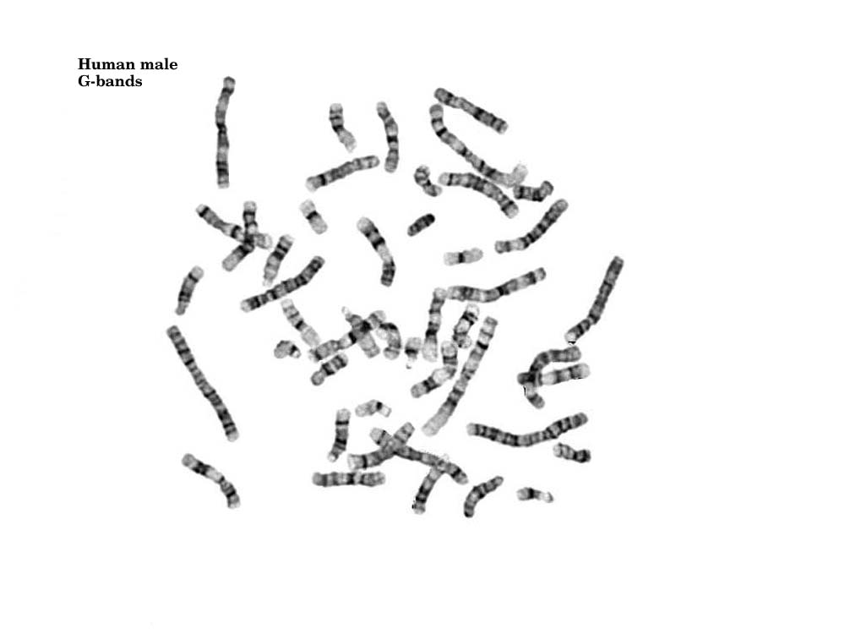
Staining produces bands.

Slide 48
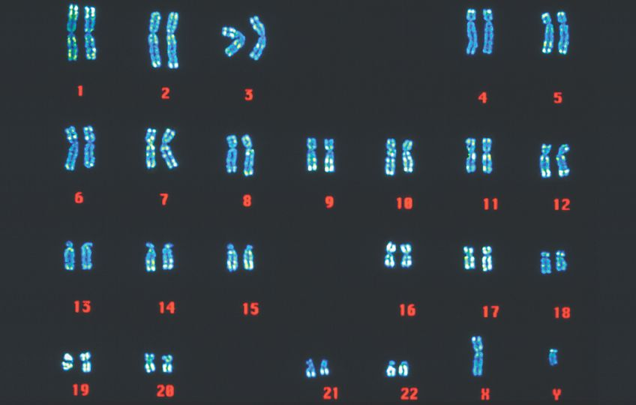
Finally, sort by shape, banding & size

Slide 49
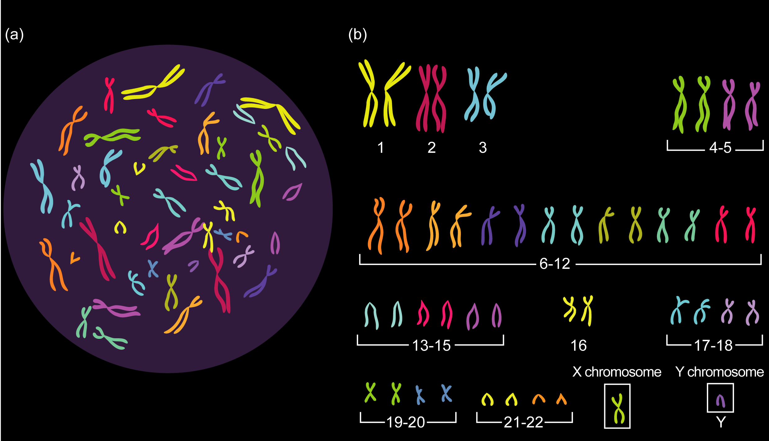

Slide 50
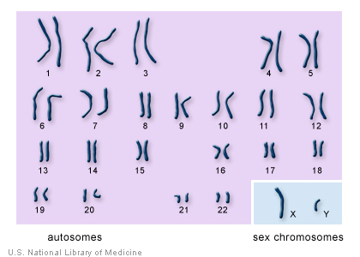
Karyotype

Slide 51
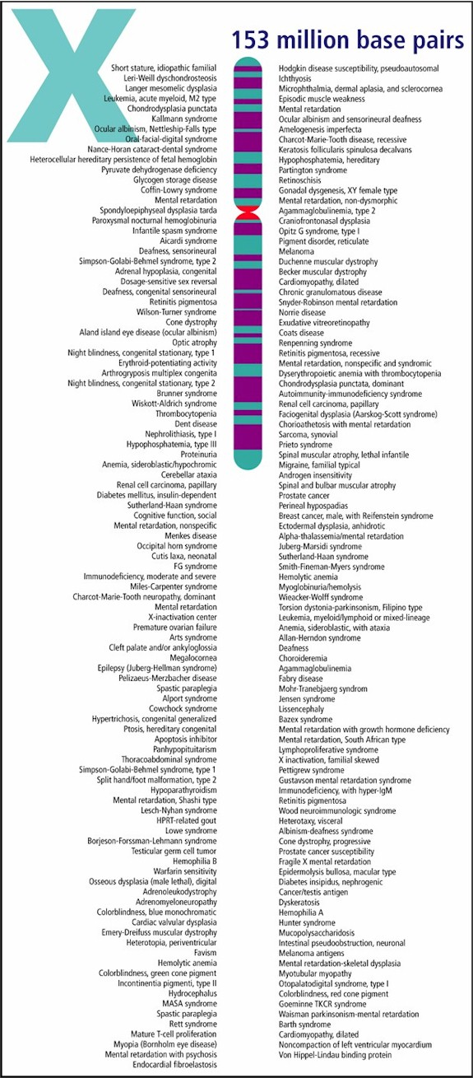
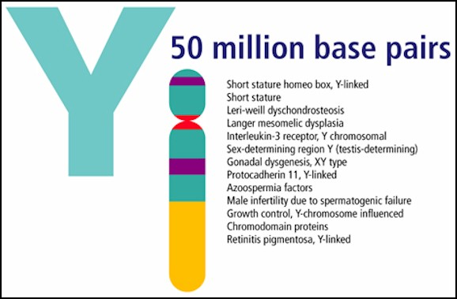

Slide 53
